Slide 1
The Team Data Science Process
Buck Woody
Applied Data Scientist
Notes:
https://medium.com/adventures-in-consumer-technology/five-steps-to-approaching-machine-learning-for-your-business-af25e91743f2

Slide 2
Session objectives and takeaways
At the end of this session, you should be
better able to…
Use a proven structure to create a successful Advanced Analytics Engagement
Understand the primary success points and how to deliver incremental wins during the project
Understand a tools-selection mechanism to select the right Data Science technologies for your project

Slide 3
What we’ll cover
Data Science is the latest tool in an organization’s analytics arsenal. Many leaders are interested in what Advanced Analytics and Data Science can do to help them, and after they investigate the possibilities they engage with a team to start a project. The initial thought is that a Data Science project is similar to any other technology project. But Data Science, unlike other IT efforts, has specific elements that are exploratory and experiment-based, which many organizations are unfamiliar with. So how do you explain the project, implement it, and keep it on track? We’ll learn the start-to-finish steps and process to engage the stakeholders on the project, how to lay out the process and timeline, define the goals, and deliver on the project. You’ll learn the pitfalls and how to avoid them, how to move the project along, and the “little wins” that will keep the customer engaged.

Slide 4

The Data Science Difference

Slide 5
Data Analytics Landscape
Data Acquisition, Storage, and Processing
Collection hygiene
Intelligent storage
Data engines (RDBMS, NoSQL)
Reporting
Query languages
Tabular results
Graphical presentation
Business Intelligence
Multi-dimensional queries
Historical aggregations
Exploration and question generation
Cognitive Intelligence
Adaptive
Interactive
Iterative and Stateful
Contextual

Slide 6
The Data Science Project Formula
Question + Data + Analysis = Answer
…which leads to a Decision/Action
“What will you do when you know the answer?”

Slide 7
The Team Data Science Process
Business Understanding
Define Objectives
Identify Data Sources
Data Acquisition and Understanding
Ingest Data
Explore Data
Modeling
Feature Selection
Create and Train Model
Deployment
Customer Acceptance
Operationalize
Testing and Validation
Update Data
Handoff
Re-train and re-score
http://aka.ms/tdsp
Notes:
It also references the Microsoft Business Analytics and AI process - https://docs.microsoft.com/en-us/azure/machine-learning/team-data-science-process/overview
A complete process diagram is here - https://azure.microsoft.com/en-us/documentation/learning-paths/data-science-process/
Some walk-throughs of the various services - https://azure.microsoft.com/en-us/documentation/articles/data-science-process-walkthroughs/
An integrated process and toolset allows for a more close-to-intent deployment
Iterations are required to close in on the solution – but are harder to manage and monitor – We’ll cover DevOps for Data Science in this course to assist.
Data Science Blog - https://buckwoody.wordpress.com/

Slide 8
The Azure Platform for Analytics and AI
Big Data
Intelligence and Advanced Analytics
Information Management
Solutions
Visualization
Data Catalog
Data Factory
Event Hubs
Data Lake
SQL Data Warehouse
Cosmos DB
Cortana, Bot Service, Cognitive Framework
HDInsight
Data Lake
Azure Storage
Stream Analytics
Analysis Services
Power BI
R
Templates and Gallery
Azure Machine Learning Services
http://aka.ms/cisc
Notes:
Azure Data Catalog - http://azure.microsoft.com/en-us/services/data-catalog (Doc It)
Azure Data Factory - http://azure.microsoft.com/en-us/services/data-factory/ (Move It)
Azure Event Hubs - http://azure.microsoft.com/en-us/services/event-hubs/ (Bring It)
Platform and Storage - Microsoft Azure – https://azure.microsoft.com/ Storage - https://docs.microsoft.com/en-us/azure/storage/ (Host It)
Azure Data Lake - https://azure.microsoft.com/en-us/solutions/data-lake/ (Store It)
Azure SQL Data Warehouse - http://azure.microsoft.com/en-us/services/sql-data-warehouse/ (Relate It)
Azure Cosmos DB - https://docs.microsoft.com/en-us/azure/cosmos-db/introduction
Cortana - https://developer.microsoft.com/en-us/Cortana and https://blogs.windows.com/buildingapps/2017/05/10/cortana-skills-kit-empowers-developers-build-intelligent-experiences-millions-users/#AXrmKPb74ugDDmG7.97 and https://www.microsoft.com/en-us/windows/cortana/cortana-skills/ (Say It)
Cognitive Services - https://www.microsoft.com/cognitive-services
Bot Framework - https://dev.botframework.com/
Azure Machine Learning - https://docs.microsoft.com/en-us/azure/machine-learning/preview/ (Learn It)
Azure HDInsight - http://azure.microsoft.com/en-us/services/hdinsight/ (Scale It)
Azure Stream Analytics - http://azure.microsoft.com/en-us/services/stream-analytics/ (Stream It)
Analysis Services - https://docs.microsoft.com/en-us/azure/analysis-services/analysis-services-overview
Power BI - https://powerbi.microsoft.com/ (See It)
All of the components within the suite - https://www.microsoft.com/en-us/cloud-platform/what-is-cortana-intelligence
Templates - https://gallery.cortanaintelligence.com/browse?orderby=freshness%20desc&skip=0&categories=%5B%2210%22%5D and https://caqs.azure.net/#gallery

Slide 9

Business Case
Wide World Importers is a company that imports and distributes products in multiple countries around the globe.
With several thousand employees, Information Technology is at the heart of our business operations, and has a significant cost.
Since we handle materials in multiple countries, we have a lot of private data, financial information, and other targets which have a high security profile. We are concerned with both external and internal attacks. In addition, many of our employees work in remote locations, some on ships and other challenging environments.
All of our IT systems have been modernized, and we’re taking in a significant amount of semi-structured data from computing devices – most of it real-time. After talking with our IT leadership, we need a way to determine anomalies within the data streams we get, and have a way to observe the anomalies in a dashboard so that we can respond to outages, threats, and changes quickly.
Notes:
More about Wide World Importers: https://docs.microsoft.com/en-us/sql/sample/world-wide-importers/overview
Anomaly Detection: https://gallery.cortanaintelligence.com/Solution/Anomaly-Detection-in-Real-time-Data-Streams

Slide 10

Design Statements
Wide World Importers is a company that imports and distributes products in multiple countries around the globe.
With several thousand employees, Information Technology is at the heart of our business operations, and has a significant cost.
Since we handle materials in multiple countries, we have a lot of private data, financial information, and other targets which have a high security profile. We are concerned with both external and internal attacks. In addition, many of our employees work in remote locations, some on ships and other challenging environments.
All of our IT systems have been modernized, and we’re taking in a significant amount of semi-structured data from computing devices – most of it real-time. After talking with our IT leadership, we need a way to determine anomalies within the data streams we get, and have a way to observe the anomalies in a dashboard so that we can respond to outages, threats, and changes quickly.
Notes:
More about Wide World Importers: https://docs.microsoft.com/en-us/sql/sample/world-wide-importers/overview
Anomaly Detection: https://gallery.cortanaintelligence.com/Solution/Anomaly-Detection-in-Real-time-Data-Streams

Slide 11
Decision Matrix
Decision | Technology | Elements | Rationale
Large amounts of semi-structured data | Azure Tables | Scale, KVP, Multi-access | Can be used by multiple technologies or queried
Fast, multiple sources of data | Event Hubs, Stream Analytics | Speed, complex processing | Fast Ingestion of massive datasets
Anomaly detection | Azure ML | API-Driven detection | Built-in algorithms, multi-dev
Reporting | SQL DB, Power BI | Ease of reporting, data visualization | Standard queries, action-based visualizations
System monitoring and management | Azure Data Factory, Application Insights | Actionable system metrics | OOB orchestration and reporting
Notes:
Another approach on decision matrices: http://www.businessnewsdaily.com/6146-decision-matrix.html

Slide 12
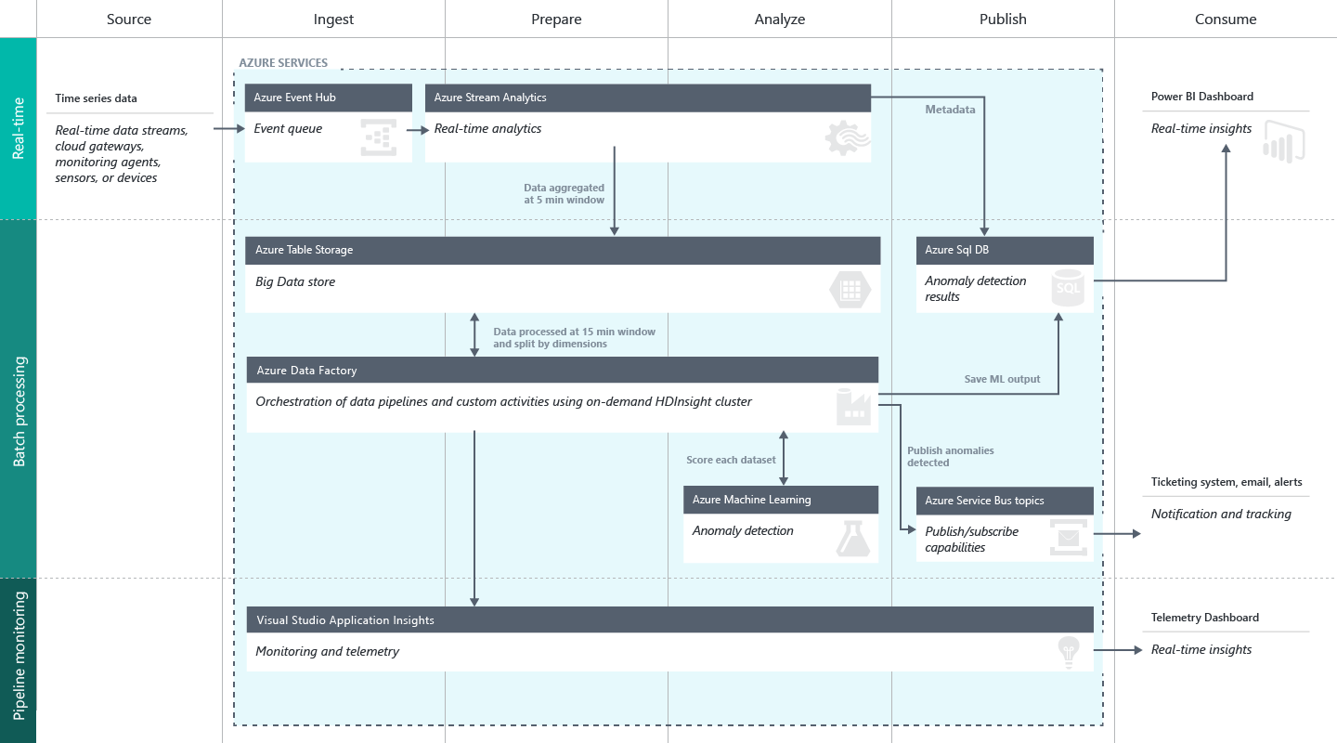
Create a Solution Workflow
Notes:
Full description is here: https://github.com/Azure/itanomalyinsights-cortana-intelligence-preconfigured-solution/blob/master/Docs/IT%20Anomaly%20Insights%20Post%20Deployment%20Instructions.md
Create your own Solution Templates: https://start.cortanaintelligence.com/CustomSolutions
More solution tutorials: https://gallery.cortanaintelligence.com/browse?categories=%5B%227%22%5D&skip=0&orderby=trending%20desc&tags=%5B%22Solution%22%5D

Slide 13
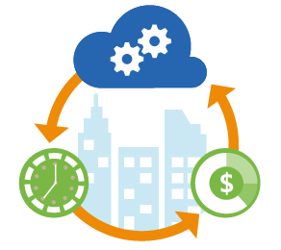
Azure DevOps for Advanced Analytics
Deployment
Tooling
Facilities and Regions
Resource Grouping
Safety
Auditing and Reporting
Troubleshooting
Service creation and setup
Security
Cost management
Monitoring and Management
Development
Automation
Options
Optimization
Regulatory requirements
Dev/Test/Production
Groups for monitoring and billing
Redundancy
Recovery strategies
Outage fallbacks
Issue identification
Resolution call tree
Telemetry data collection and storage
Report distribution
Automated alerts
Networking and Hybrid
Support
Scheduling
Migration
Notes:
Deployment
Service Creation and Setup - https://azure.microsoft.com/en-us/offers/ms-azr-0003p/
Authentication and Access - https://docs.microsoft.com/en-us/azure/active-directory/connect/active-directory-aadconnect
Security best practices - https://docs.microsoft.com/en-us/azure/active-directory/role-based-access-control-configure
Cost Management (Pricing) - https://azure.microsoft.com/en-us/pricing/
Migrations - https://msdn.microsoft.com/en-us/library/dn727097.aspx
Tools
The Azure Portal - https://docs.microsoft.com/en-us/azure/azure-portal-overview
PowerShell - https://docs.microsoft.com/en-us/powershell/azure/overview?view=azurermps-3.8.0
CLI - https://docs.microsoft.com/en-us/cli/azure/install-azure-cli
Others - Visual Studio, System Center, Jenkins, chef
Azure Automation - https://azure.microsoft.com/en-us/services/automation/
Facilities and Regions
Locations - https://azure.microsoft.com/en-us/regions/
Azure Trust Center - https://azure.microsoft.com/en-us/support/trust-center/
Resource Grouping
Resource Groups - https://docs.microsoft.com/en-us/azure/azure-resource-manager/resource-group-overview
Using the ARM model - https://docs.microsoft.com/en-us/azure/azure-resource-manager/resource-group-template-deploy-portal
Safety - https://docs.microsoft.com/en-us/azure/storage/storage-redundancy
Auditing - https://msdn.microsoft.com/en-us/library/mt662411.aspx?f=255&MSPPError=-2147217396
Troubleshooting and Support - https://azure.microsoft.com/en-us/blog/understanding-azure-troubleshooting-and-support/
Special considerations for Advanced Analytics:
Account management
Storage and redundancy
Privacy and data protection
Scheduling and Pipelined workflows
Networking - https://www.simple-talk.com/cloud/cloud-data/azure-networking-sql-server-dbas/
Optimization
Security
Advanced Analytics Services awareness – data transfer, storage and processing
Dependencies and interactions
Full tutorial: https://github.com/Azure/DevOps-For-AI-Apps/blob/master/Tutorial.md

Slide 14
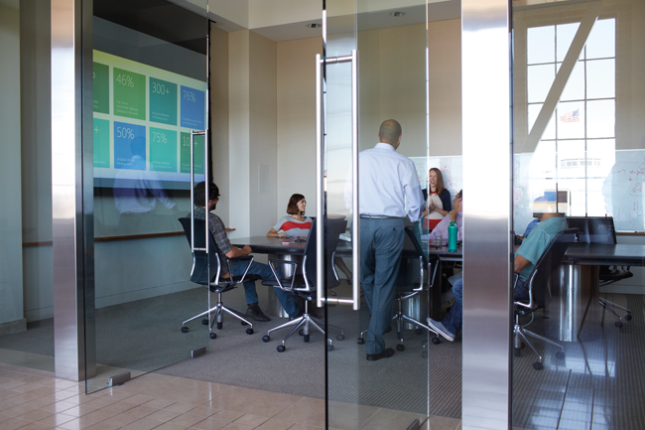
Success Factors for the Data Science Project

Slide 15
Success Factor: The Question
Question + Data + Analysis = Answer
Specific
Measurable
Unanimous
Actionable
Baselined
From Business Question to Data Science Question:
When should we service this machine so that it doesn’t break?
What is the probability that this machine will fail at a given time?
Notes:
The five questions data science can answer - https://docs.microsoft.com/en-us/azure/machine-learning/machine-learning-data-science-for-beginners-the-5-questions-data-science-answers
The question you can answer with data - https://docs.microsoft.com/en-us/azure/machine-learning/machine-learning-data-science-for-beginners-ask-a-question-you-can-answer-with-data
Copy other people’s work to do data science - https://docs.microsoft.com/en-us/azure/machine-learning/machine-learning-data-science-for-beginners-copy-other-peoples-work-to-do-data-science

Slide 16
Success Factor: The Data
Question + Data + Analysis = Answer
Sufficient
Reliable
Accessible
Related
Notes:
Is your data ready for data science - https://docs.microsoft.com/en-us/azure/machine-learning/machine-learning-data-science-for-beginners-is-your-data-ready-for-data-science
Correlation does not equal Causation - http://www.tylervigen.com/spurious-correlations

Slide 17
Success Factor: The Analysis
Question + Data + Analysis = Answer
Practical
Applicable
Computable
Verified
Get here as quickly as possible
Notes:
Predict an answer with a simple model - https://docs.microsoft.com/en-us/azure/machine-learning/machine-learning-data-science-for-beginners-predict-an-answer-with-a-simple-model

Slide 18
Success Factor: The Answer
Question + Data + Analysis = Answer
Real
Usable
Impactful
Valuable (Cost/Benefit)
Assigned
“What will you do when you know the answer?”
Notes:
Cost/Benefit Analysis: https://www.mindtools.com/pages/article/newTED_08.htm

Slide 19
Related content
Data Science Blog: https://buckwoody.wordpress.com/
The Team Data Science Process: http://tinyurl.com/ya3n7p9z
Microsoft Business Analytics and AI: http://tinyurl.com/ydfnduu3

Slide 20
Q&A

Slide 21
Handout:
http://tinyurl.com/y7kkxkkg

